Slide 1
ECEN 150 Circuit Analysis I
Midterm Review

Slide 2
Midterm Exam Review
Midterm exam has 25 questions covering Chapters 1 through Chapter 4.
The exam will be a closed book in the Testing Center.
A 3 x 5 index card with equations of your choice and a calculator are to be used for this exam. Phones cannot be used in the Testing Center.
Auto-graded exam with many short answers, most requiring calculations.
This exam counts for 15% of overall grade, as does the final exam.
Exam Suggestions:
1.) While you have a few days during which to take the exam, it must be taken during Testing Center hours.
2.) Know how to do HWs, as several questions similar to HW problems.
3.) Filling a 3 x 5 index card with equations of your choice is a helpful study method.
3.) The exam focuses on material discussed in class, along with HW and Labs.
4.) If you understand the HWs and labs, you should do well on this exam.

Slide 3
Ohm’s Law
Ohm’s Law Triangle
v = iR
i = v/R
R = v/i
Knowing 2 out of 3 enables us to solve for the unknown quantity.
v
i
R
Notes:
Graphic by BYU-Idaho Campus Curriculum Development in Illustrator

Slide 4
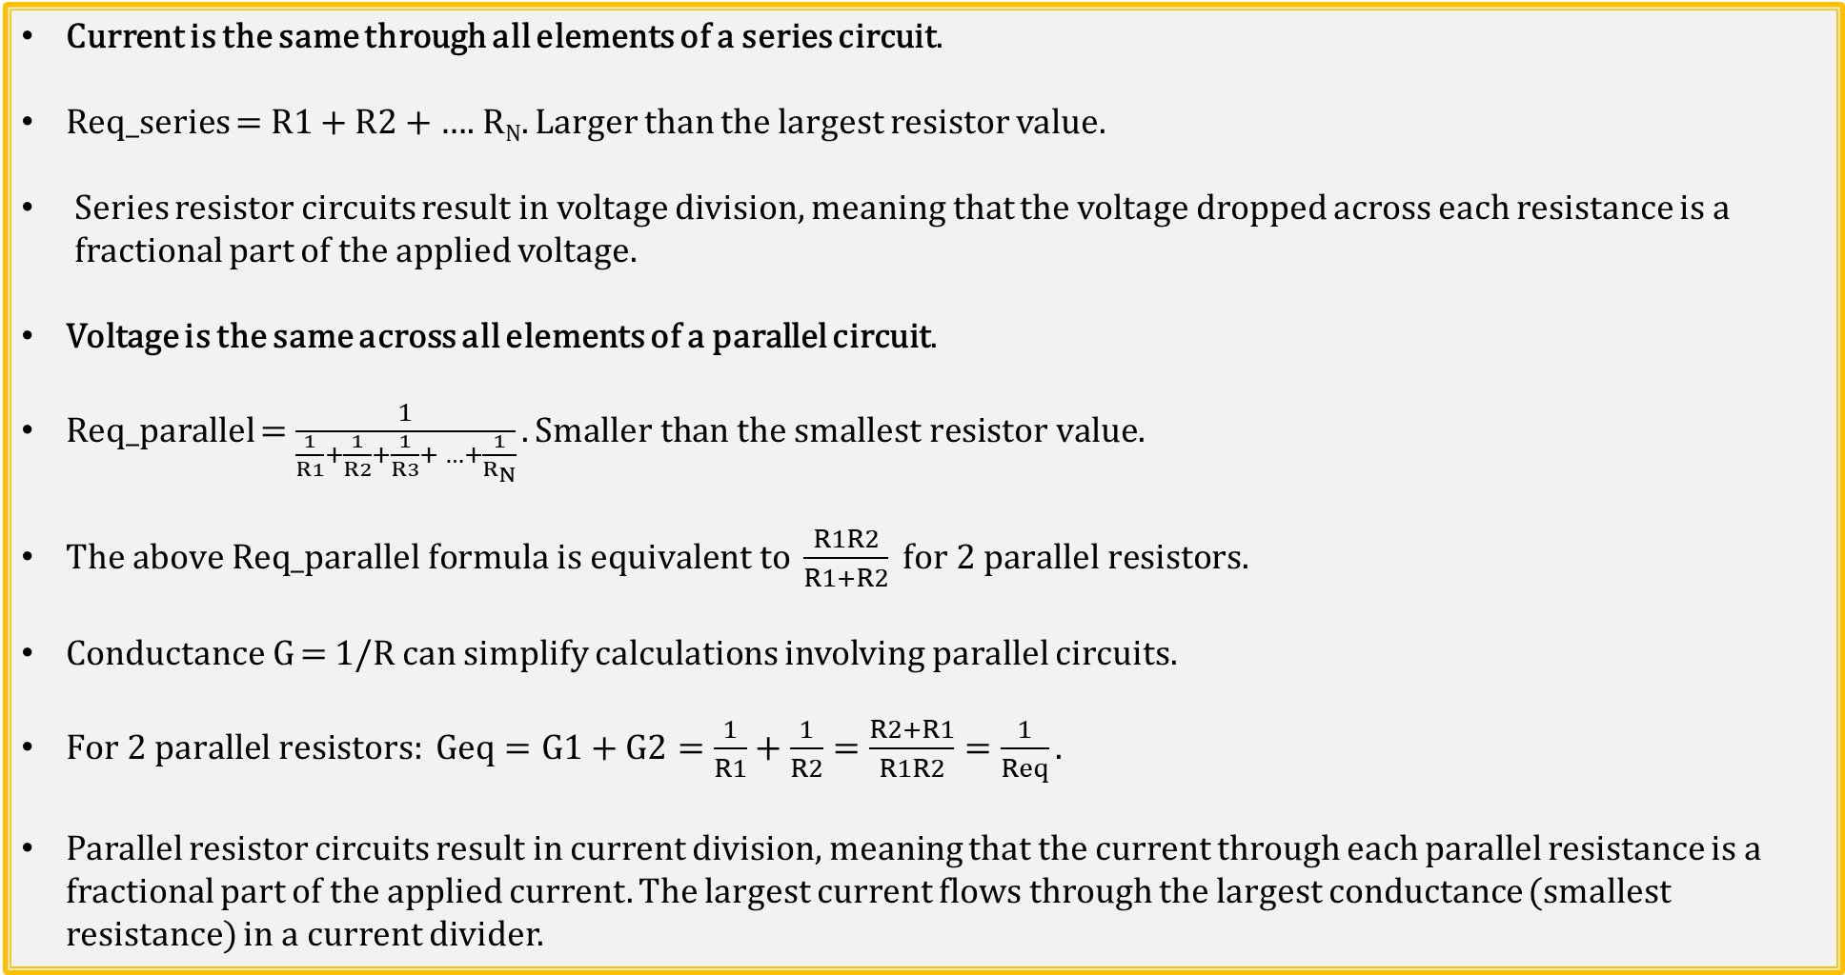
Series versus Parallel Resistor Circuits
Current is the same through all elements of a series circuit.
Req_series = R1 + R2 + …. R_{N}. Larger than the largest resistor value.
Series resistor circuits result in voltage division, meaning that the voltage dropped across each resistance is a fractional part of the applied voltage.
Voltage is the same across all elements of a parallel circuit.
Req_parallel = $\frac{1}{\frac{1}{R1}+\frac{1}{R2}+\frac{1}{R3}+ …+\frac{1}{R_{N}}}. Smaller than the smallest resistor value.$
$The above \text{Req}\text{_}\text{parallel} formula is equivalent to \frac{R1R2}{R1+R2} for 2 parallel resistors.$
Conductance G = 1/R can simplify calculations involving parallel circuits.
$For 2 parallel resistors: Geq=G1+G2=\frac{1}{R1}+\frac{1}{R2}=\frac{R2+R1}{R1R2}=\frac{1}{Req}.$
Parallel resistor circuits result in current division, meaning that the current through each parallel resistance is a fractional part of the applied current. The largest current flows through the largest conductance (smallest resistance) in a current divider.
Notes:
Image by instructor

Slide 5
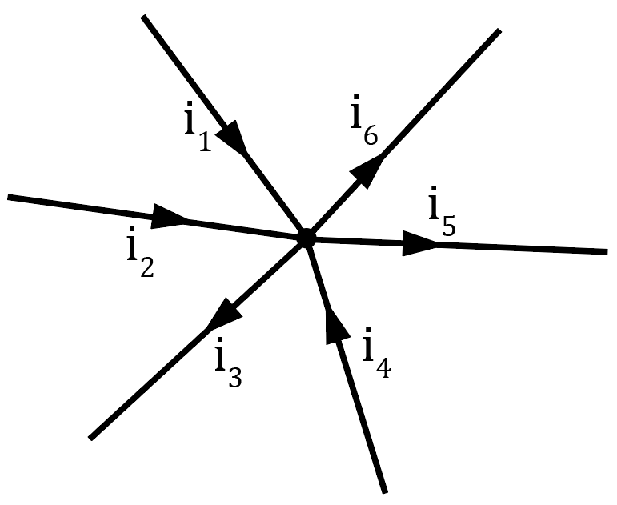
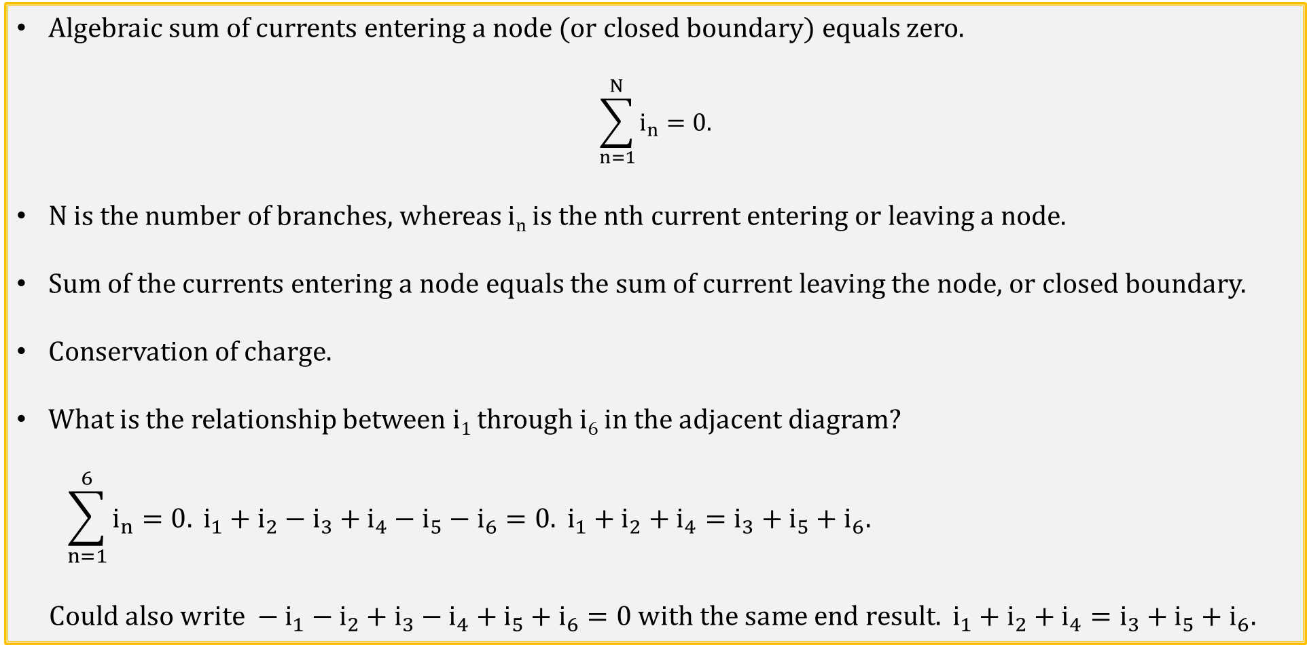
Kirchhoff’s Current Law (KCL)
Algebraic sum of currents entering a node (or closed boundary) equals zero.
$$\sum_{n=1}^{N}{i_{n}=0.}$$
N is the number of branches, whereas i_{n} is the nth current entering or leaving a node.
Sum of the currents entering a node equals the sum of current leaving the node, or closed boundary.
Conservation of charge.
What is the relationship between i₁ through i₆ in the adjacent diagram?
$$\sum_{n=1}^{6}{i_{n}=0.} i_{1}+i_{2}−i_{3}+i_{4}−i_{5}−i_{6}=0. i_{1}+i_{2}+i_{4}=i_{3}+i_{5}+i_{6}.$$
$$Could also write −i_{1}−i_{2}+i_{3}−i_{4}+i_{5}+i_{6}=0 with the same end result. i_{1}+i_{2}+i_{4}=i_{3}+i_{5}+i_{6}.$$
Notes:
Image by instructor

Slide 6
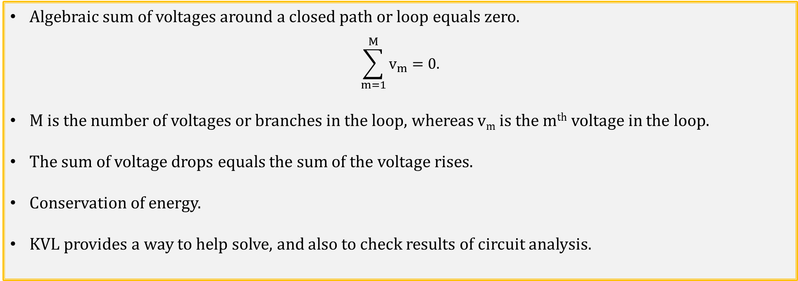
Kirchhoff’s Voltage Law (KVL)
Algebraic sum of voltages around a closed path or loop equals zero.
$$\sum_{m=1}^{M}{v_{m}=0.}$$
M is the number of voltages or branches in the loop, whereas v_{m} is the m^{th} voltage in the loop.
The sum of voltage drops equals the sum of the voltage rises.
Conservation of energy.
KVL provides a way to help solve, and also to check results of circuit analysis.
Notes:
Image by instructor

Slide 7
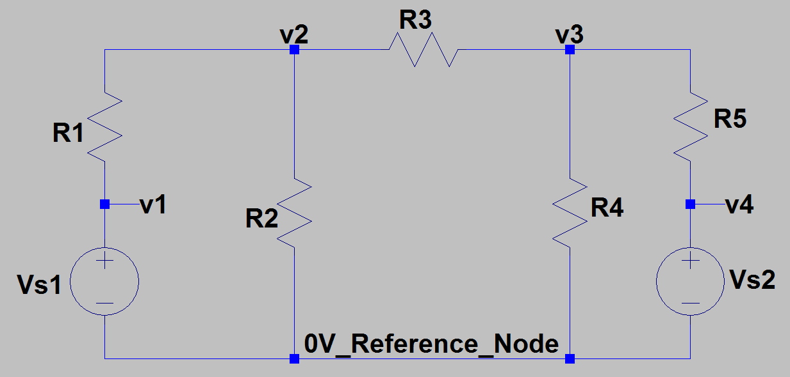
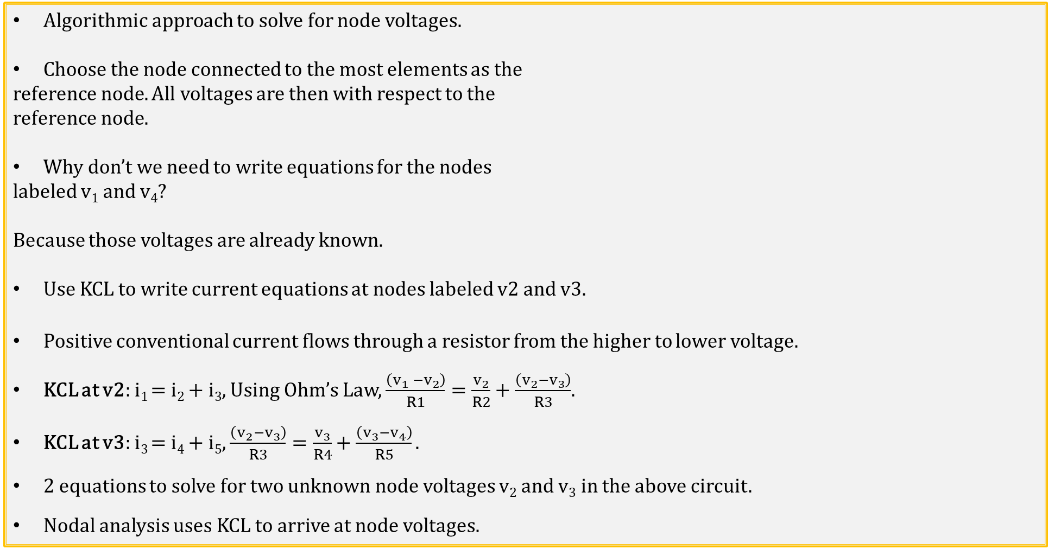

Nodal Analysis
Algorithmic approach to solve for node voltages.
Choose the node connected to the most elements as the
reference node. All voltages are then with respect to the
reference node.
Why don’t we need to write equations for the nodes
labeled v₁ and v₄?
Because those voltages are already known.
Use KCL to write current equations at nodes labeled v2 and v3.
Positive conventional current flows through a resistor from the higher to lower voltage.
KCL at v2: i₁ = i₂ + i₃, Using Ohm’s Law, $\frac{\left(v_{1} −v_{2}\right)}{R1}=\frac{v_{2}}{R2}+\frac{\left(v_{2}−v_{3}\right)}{R3}$.
KCL at v3: i₃ = i₄ + i₅, $\frac{\left(v_{2}−v_{3}\right)}{R3}=\frac{v_{3}}{R4}+\frac{\left(v_{3}−v_{4}\right)}{R5}.$
2 equations to solve for two unknown node voltages v₂ and v₃ in the above circuit.
Nodal analysis uses KCL to arrive at node voltages.
i₁
i₃
i₃
i₅
i₂
i₄
i_{R1}
+
_
v_{higher}
v_{lower}
$$i_{R1}=\frac{v_{higher}−v_{lower}}{R1}.$$
R1

Slide 8
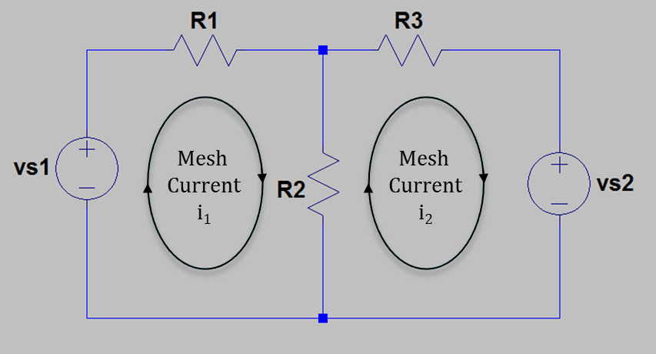
Mesh (Loop) Analysis
Another algorithmic approach.
The adjacent circuit has two meshes, i.e. Mesh 1 and Mesh 2.
Resistor R2 is common to both meshes with
i_{R2} being algebraic sum of i₁ and i₂ mesh currents.
Convention is to define clockwise mesh currents. If actual
current flow is in the opposite direction of a clockwise then the
solved for mesh current will have a negative sign.
Mesh current i₁ also equals branch current i_{R1}, and mesh current i₂ also equals branch current i_{R3}. Branch current i_{R2} equals algebraic sum of i₁ and i₂ mesh currents.
Use KVL to write voltage equations for meshes 1 and 2.
Mesh 1: -v_{s1} + i₁R1 + i₁R2 – i₂R2 = 0, (R1 + R2)i₁ – R2i₂ = v_{s1}.
Mesh 2: i₂R2 - i₁R2 + i₂R3 + v_{s2} = 0, -R2i₁ + (R2 + R3)i₂ = -v_{s2}.
Solve for mesh currents i₁ and i₂.
Mesh analysis uses KVL to arrive at mesh currents.

Slide 9
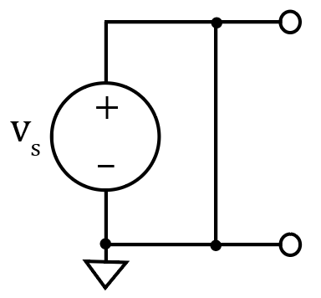
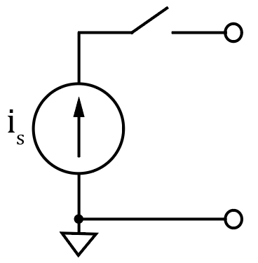
Superposition Principle
The voltage across or current through an element in a linear circuit is the algebraic sum of the voltages across or the currents through that element due to each independent source acting alone. (Additivity property of linear systems).
Good way to solve systems with multiple sources.
Consider each independent source separately, then algebraically sum the results together.
To consider each independent source separately, independent sources not being considered must be turned off.
Dependent sources are left intact because they are controlled by circuit variables.
How do you turn off a voltage source?
Set it equal to zero. Can short across it for schematics to achieve 0 V,
but don’t do this for real circuits.
How do you turn off a current source?
Simply remove it, i.e. open circuit it from the circuit, because a current
source with zero current provides 0 A at all possible voltages, which is
achieved with an open circuit.

Slide 10
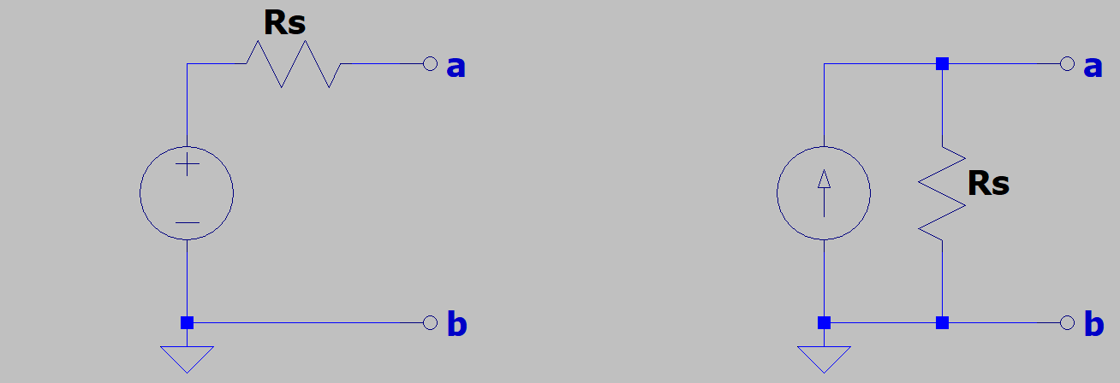
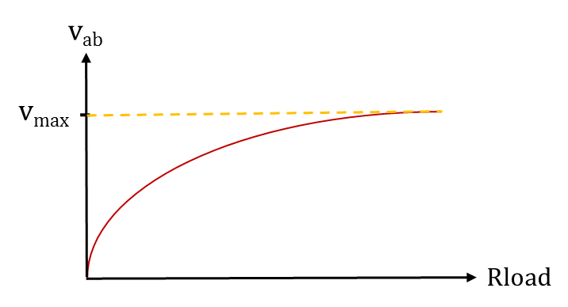
Source Transformations (Continued)
Source transformation relationships: R_{s} = R_{s}, i_{s} = v_{s}/R_{s}, v_{s} = i_{s}R_{s}.
Equivalence means that the v-i characteristics at the a and b terminals are identical with the original circuit for any given load attached, even though the internal circuit components can be different.
Both of the above circuits exhibit the adjacent output voltage
versus load resistance characteristics for Rload attached to the a and b
terminals and varying from zero (short-circuit ) to a value much larger
than the source resistance R in the above circuits.
v_{max} = v_{s} for the practical voltage source circuit.
v_{max} = i_{s}R_{s} for the practical current source circuit.
v_{s} = i_{s}R_{s}
i_{s} = v_{s}/R_{s}

Slide 11
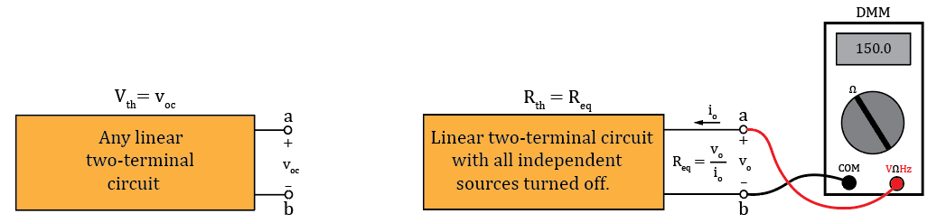
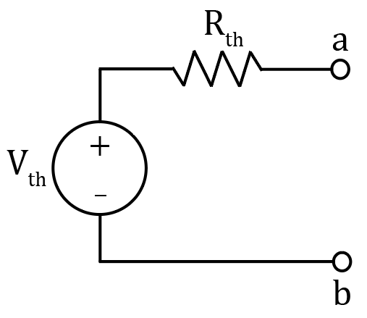
Thevenin’s Theorem
Sometimes, we only care about what happens at the output terminals of a given circuit when connected to some load. Thevenin’s and Norton’s Theorems provide simplified equivalent circuits for any linear circuit having two output terminals.
Thevenin’s Theorem: Any linear two-terminal circuit can be replaced by a voltage source (V_{th}) in series with a resistance (R_{th}). The voltage source (V_{th}) is the open-circuit voltage at the output terminals and the resistance (R_{th}) is the equivalent resistance between the output terminals with all independent sources turned off.
A Thevenin’s Equivalent circuit is a practical voltage source.
The resulting Thevenin’s equivalent circuit provides equivalent
performance as the original circuit with regards to an external loads.
Thevenin’s Theorem Diagrams
Notes:
Image by instructor

Slide 12
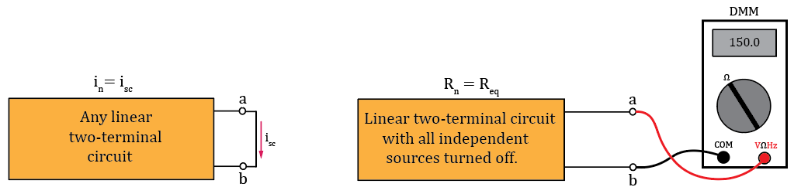
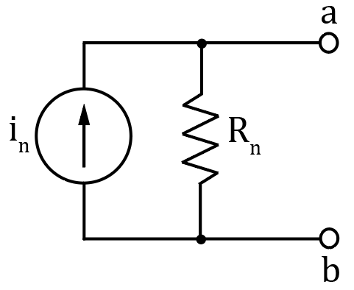
Norton’s Theorem
Norton’s Theorem: Any linear two-terminal circuit can be replaced by a current source (I_{n}) in parallel with a resistance (R_{n}). The current source (I_{n}) is the short-circuit current at the output terminals and the resistance (R_{n}) is the equivalent resistance between the output terminals with all independent sources turned off.
A Norton’s Equivalent circuit is a practical current source.
The resulting Norton’s equivalent circuit provides equivalent
performance as the original circuit with regards to an external load.
The Norton resistance R_{n} is equivalent to the Thevenin resistance R_{th}.
Norton’s Theorem Diagrams
Notes:
Image by instructor

Slide 13
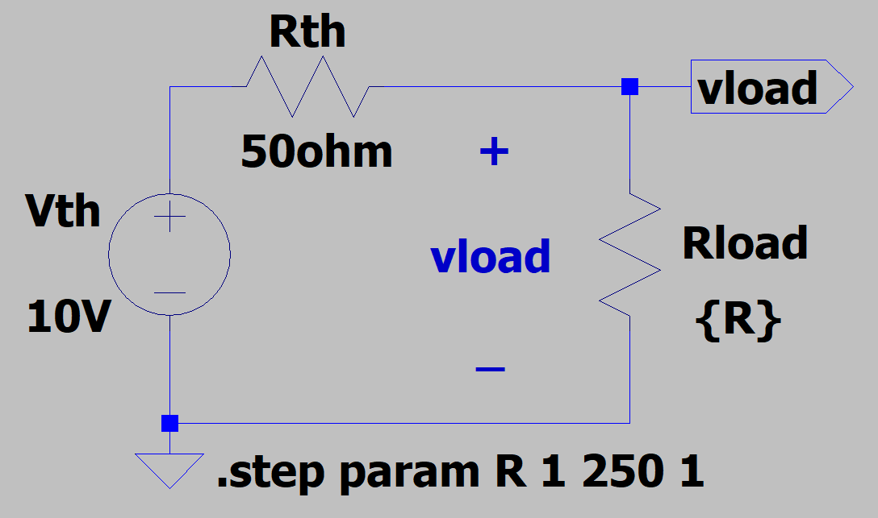
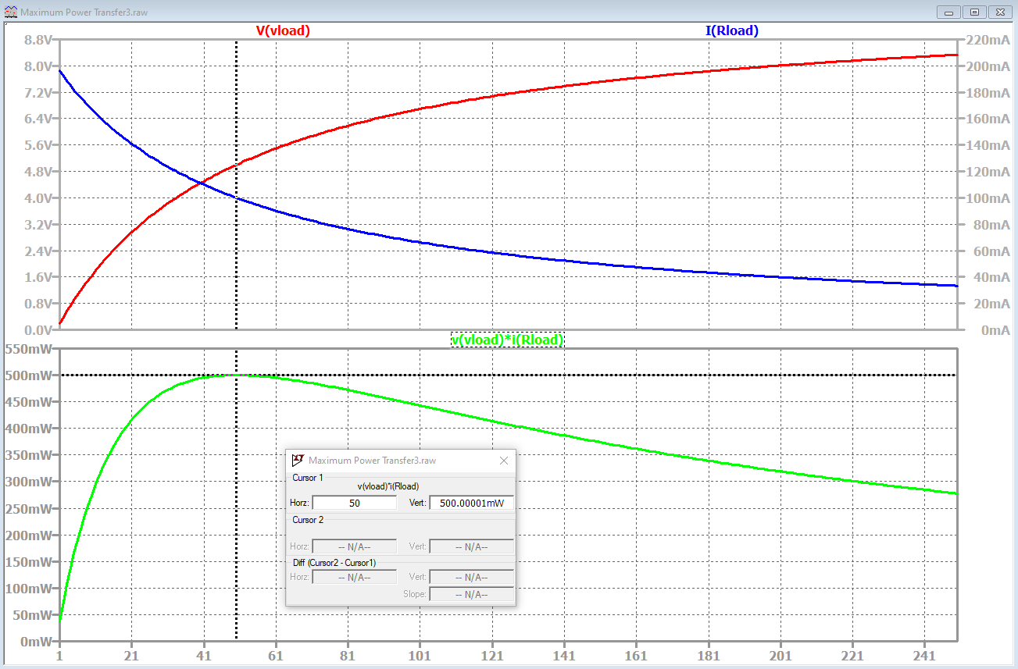
Maximum Power Theorem
Maximum Power Theorem - Maximum output power to the
load is obtained from a practical source when the load resistance
is equal to the Thevenin or Norton Resistance of the source.
Important implications for audio speakers, transmitting antennas, etc.
Adjacent graph shows v_{load}, i_{load} and p_{load} = v_{load}i_{load} from above circuit as load resistance is swept in value from 0.1 Ω to 250 Ω.
The graph shows that the maximum power equals 500 mW and occurs when R_{load} = R_{th}, as given by the Maximum Power Theorem.
Notes:
Image by instructor

Slide 14
The End

Slide 15
Extra

Slide 16
Cheating/Plagiarism
“This week I am going to give you two examinations: one in Circuit Analysis and one in Honesty. I hope you will pass them both. But if you must fail one, let it be on circuit analysis. For there are many good people in the world today who cannot pass an examination in Circuit Analysis, but there are no good people in the world today who cannot pass an examination in Honesty”. Paraphrasing from “As a Man Soweth” by L. Tom Perry, April 1976 General Conference.
“Integrity includes virtue, cleanliness, and honesty. In our world there is so much of deceit. We learn of cheating in the classroom, cheating in business, cheating in marriage, and so on. Even though these acts may not be discovered by others, the soul of a cheater suffers. Self respect vanishes, conscience is warped and character crumbles”. President Nelson.
First item on the CES Honor Code is “Be Honest”.
You will be ask if you are honest when renewing your Ecclesiastical Endorsement. Strive to be able to provide an honest answer to the honesty question.
Demonstrating integrity and trustworthiness is of more long term value than the letter grade you get in any college class.
People cheat to get ahead, but ironically end up further behind in the long term. Be wise!
100% of BYU-I Students that knowingly cheat in their classes regret or will regret their cheating.

Slide 17
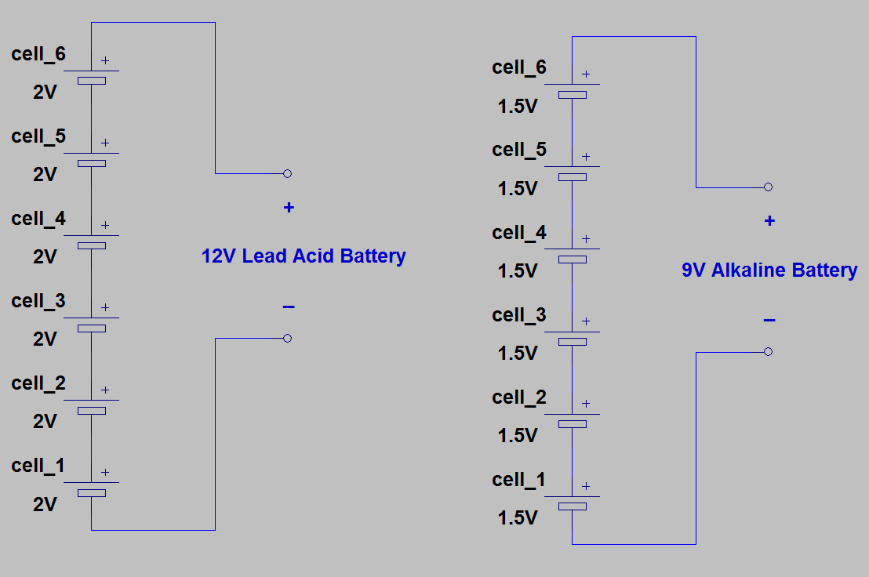
Series Voltage Sources
Series Voltage Sources – Good idea.
Batteries with voltages > 4 V are usually strings of series connected cells.
Notes:
Image by instructor

